Slide 1

Renewals System Redesign
Redesigning for Clarity, Efficiency, & User Satisfaction

Slide 2
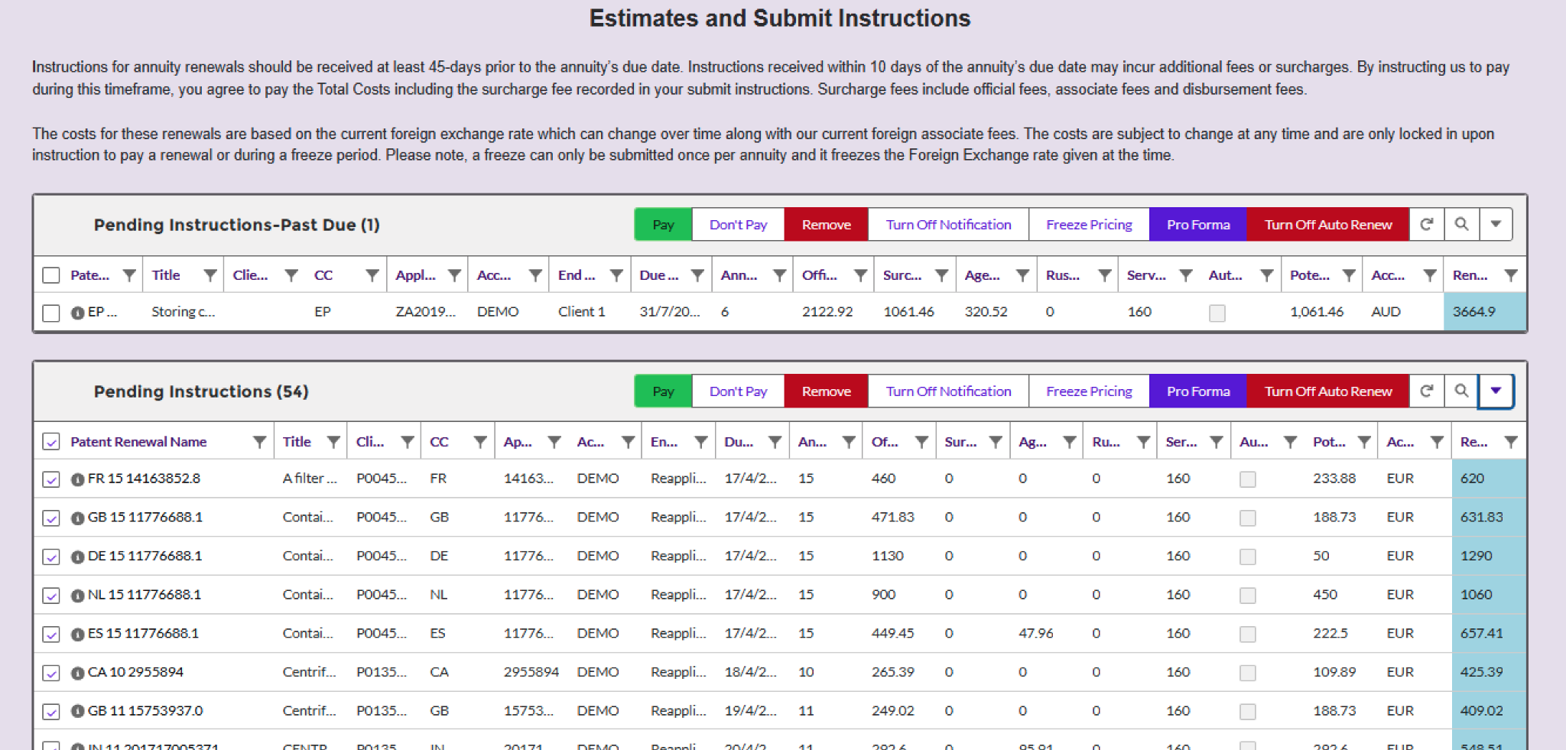
Current Design

Slide 3
*
The ZedView Challenge
Current Implementation:
Third-party datatable developed by Abra
Native to Salesforce but with significant limitations
Key Limitations:
Closed source with limited customization options
Only exports to CSV (insufficient for some clients)
No multi-language functionality
Outdated interface with column width issues
Background

Slide 4
*
Table Readability
Pain points
Column titles are truncated
Visual hierarchy is lacking to guide the eye
*This forces users to waste time repeatedly adjusting the interface
*It makes scanning for specific information much more difficult
*It creates cognitive load as users have to mentally fill in truncated information

Slide 5
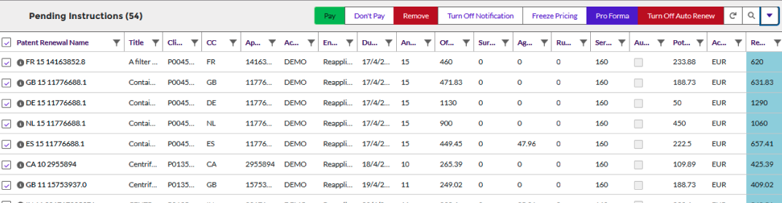
*
Status Visibility
No visual differentiation between urgent and non-urgent items
Difficult to quickly identify renewals requiring immediate attention
Pain points

Slide 6
*
Action Framework
Too many action buttons visible simultaneously
No clear indication of primary actions versus secondary options
No logical grouping of related actions
Pain points

Slide 7
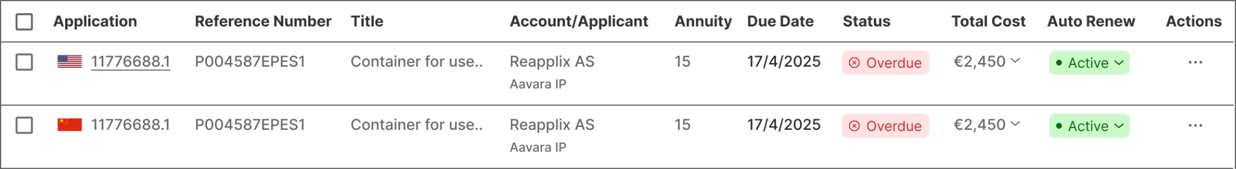
1.
HMW improve table readability & column persistence?
The Design Approach

Slide 8
1.
HMW improve table readability & column persistence?
The Design Approach

Slide 9

1.
HMW improve table readability & column persistence?
The Design Approach
Removed Columns
Eliminated non-essential information to reduce visual clutter

Slide 10

1.
HMW improve table readability & column persistence?
The Design Approach
Removed Columns
Combined related data
Eliminated non-essential information to reduce visual clutter
Merged related information for better scanning

Slide 11

1.
HMW improve table readability & column persistence?
The Design Approach
Removed Columns
Combined related data
6 1
Eliminated non-essential information to reduce visual clutter
Merged related information for better scanning
All the pricing info in one place

Slide 12
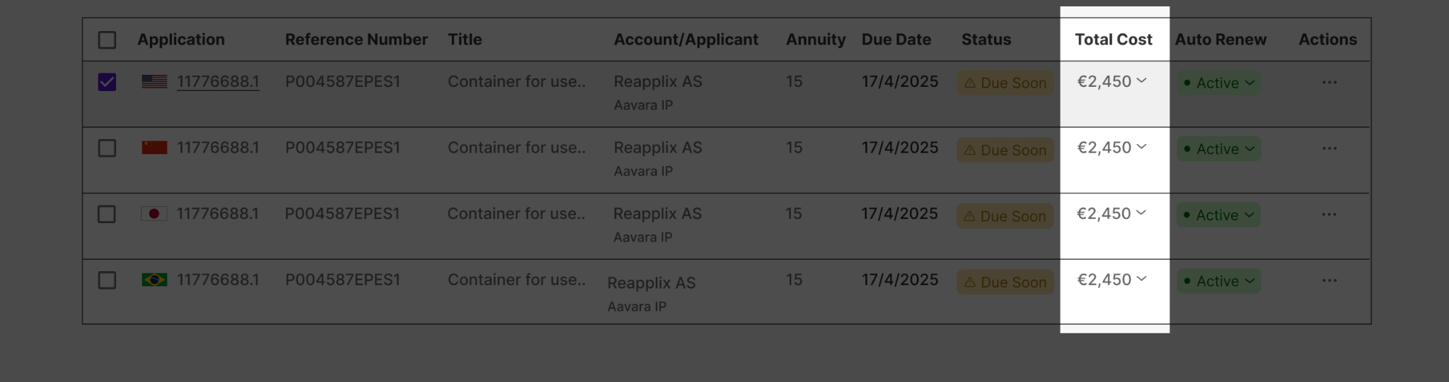

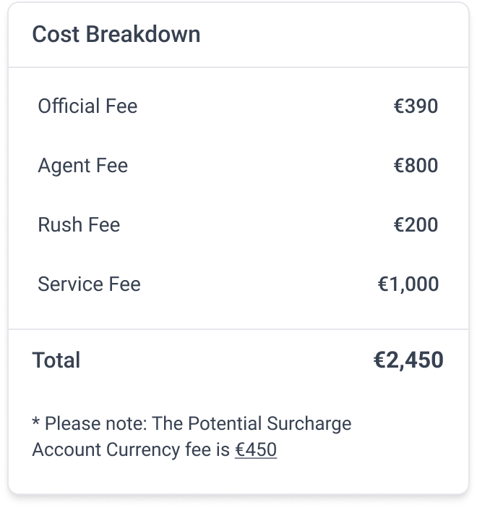
1.
HMW improve table readability & column persistence?
The Design Approach

Slide 13
2.
HMW organize information to reduce cognitive load?
HMW organize information to reduce cognitive load?
The Design Approach
The Design Approach
Regions names
👍🏻
Immediate visual recognition without reading

Slide 14
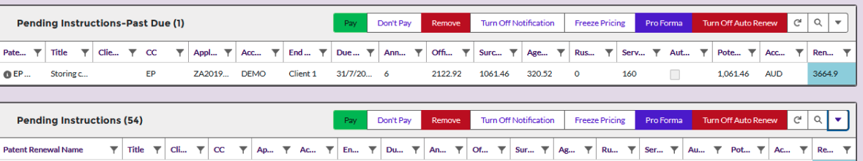
2.
HMW organize information to reduce cognitive load?
The Design Approach
The Design Approach
two separate tables
One single unified view

Slide 15
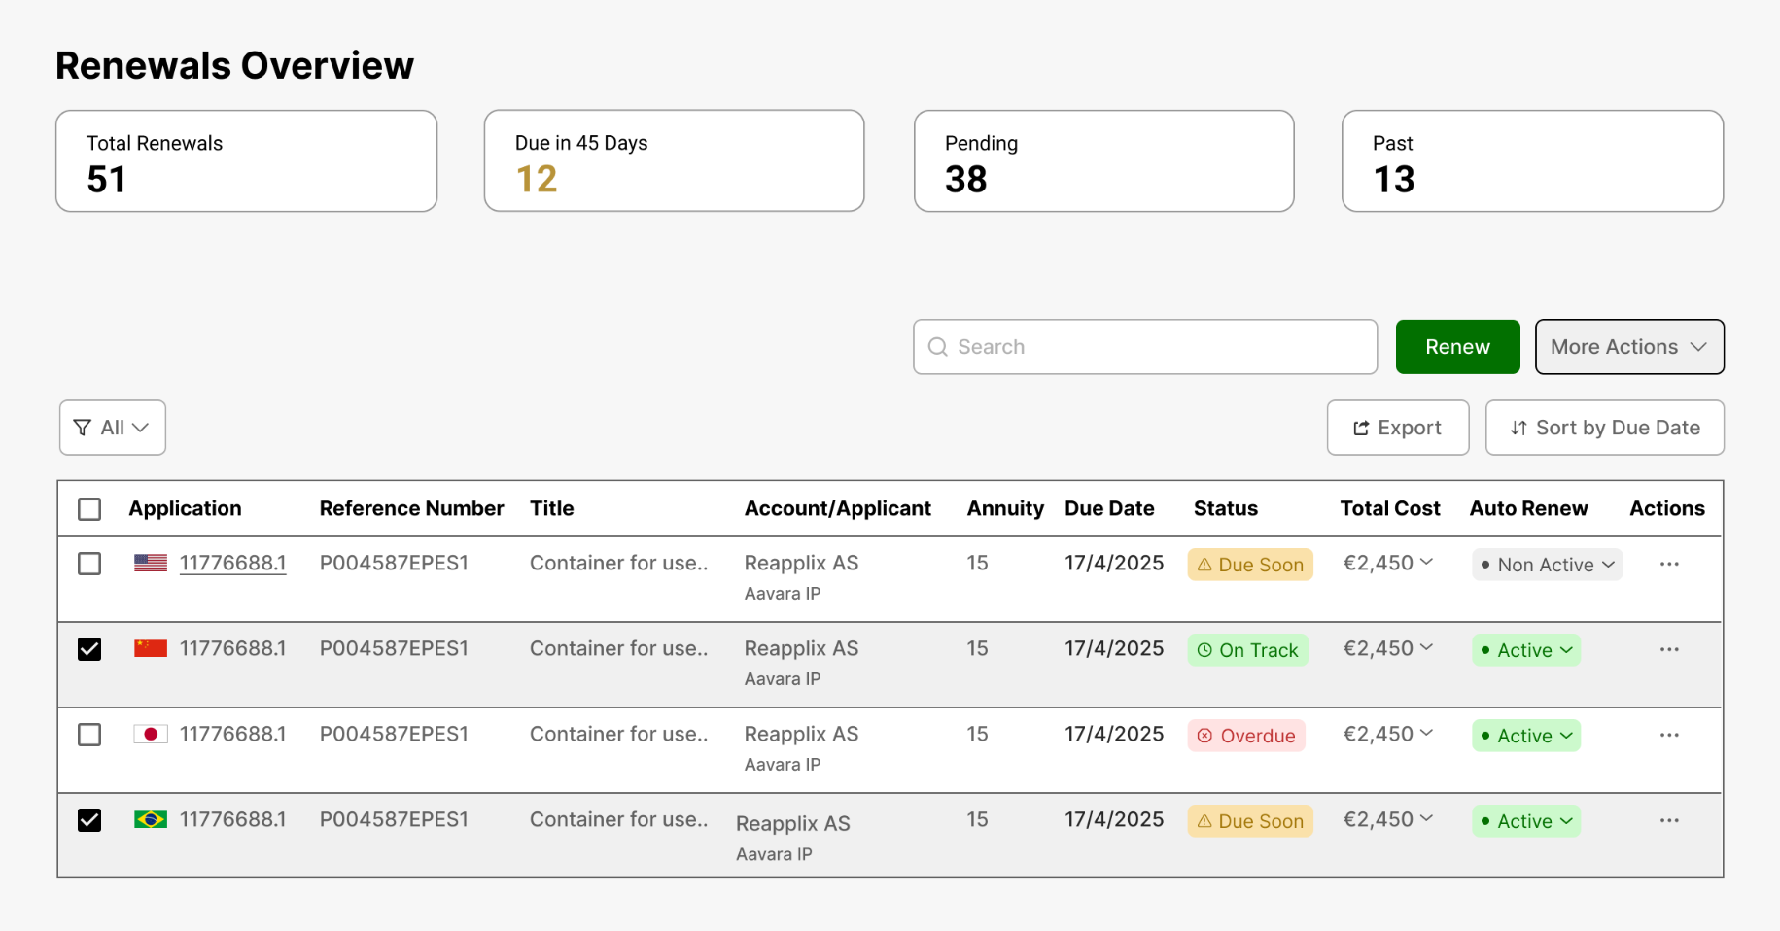
2.
HMW organize information to reduce cognitive load?
The Design Approach
The Design Approach
👍🏻
Centralized operations in one coherent view

Slide 16
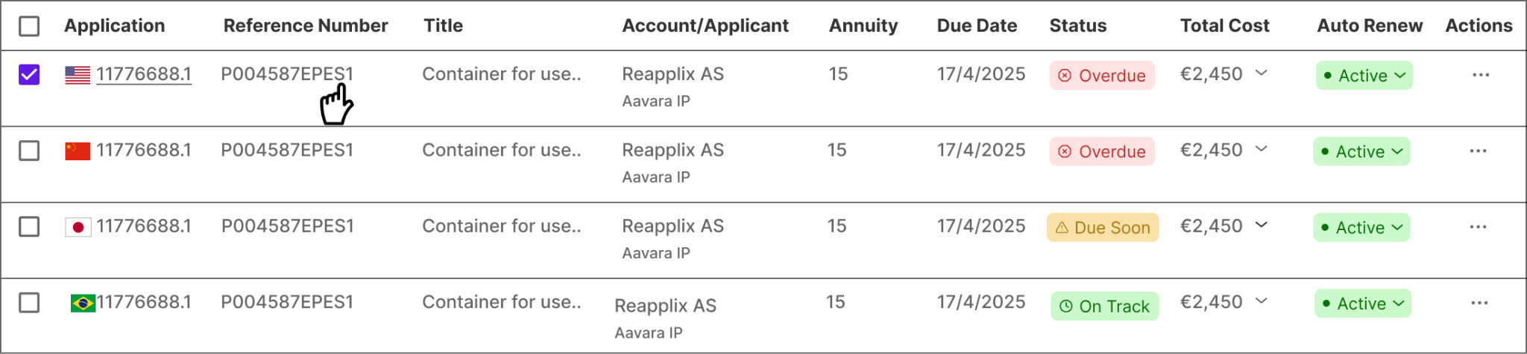
3.
HMW help users quickly identify priority renewals?
The Design Approach
The Design Approach
* Created color-coded status system (red/yellow/green)
👍🏻
Instant understanding of priorities

Slide 17
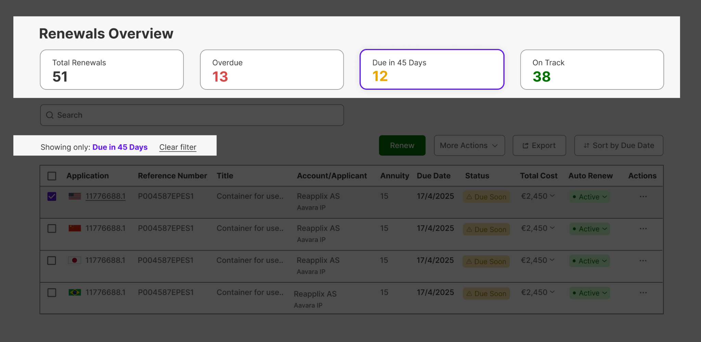
3.
HMW help users quickly identify priority renewals?
The Design Approach
The Design Approach
👍🏻
Immediately see their workload distribution without scanning the entire table

Slide 18

4.
HMW create a clear action framework?
The Design Approach
The Design Approach

Slide 19
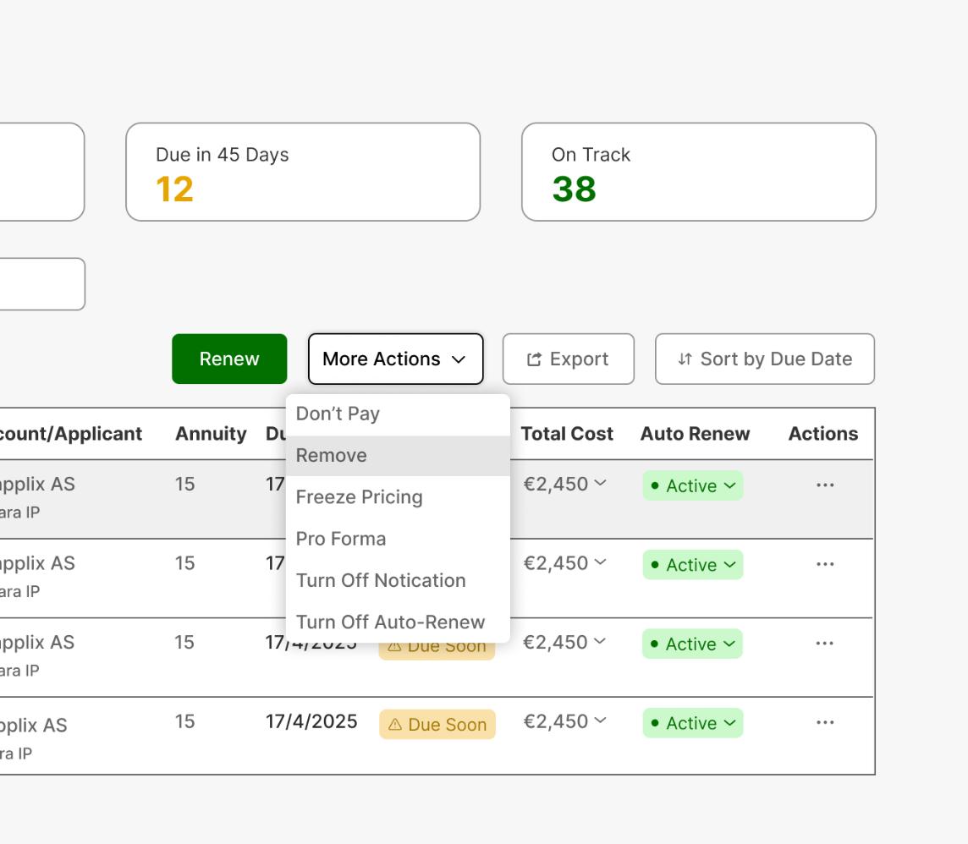
4.
HMW create a clear action framework?
The Design Approach
The Design Approach
Renamed primary button from "Pay" to "Renew" to match user goal
Created visual hierarchy between primary and secondary actions
*
*

Slide 20
Product Update 27/3’

